Slide 1

Confusion Matrix
By Aksadur Rahman
aksadur@yahoo.com

Slide 2
Agenda
Confusion Matrix
False/True Positive
False/True Negative
Precision
Recall
F1 Score

Slide 3
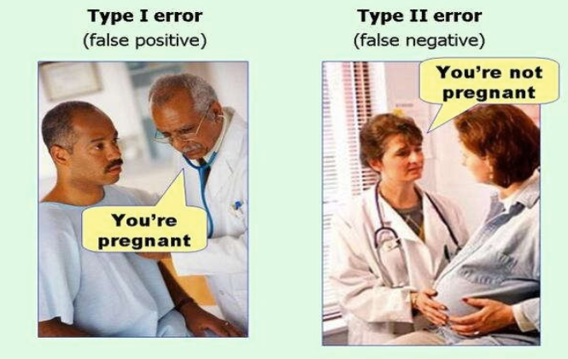
Confusion Matrix

Slide 4
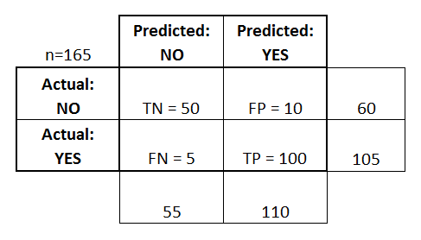
Confusion Matrix in Machine Learning
Confusion Matrix
The confusion matrix is the primary method used to validate a classifier. Most of the model quality and accuracy metrics are based on the values of the confusion matrix. This matrix is a table that contains information about the actual and predicted values for a classifier.
True positives (TP): These are cases in which we predicted yes (they have the disease), and they do have the disease.
True negatives (TN): We predicted no, and they don't have the disease.
False positives (FP): We predicted yes, but they don't actually have the disease. (Also known as a "Type I error.")
False negatives (FN): We predicted no, but they actually do have the disease. (Also known as a "Type II error.")

Slide 5
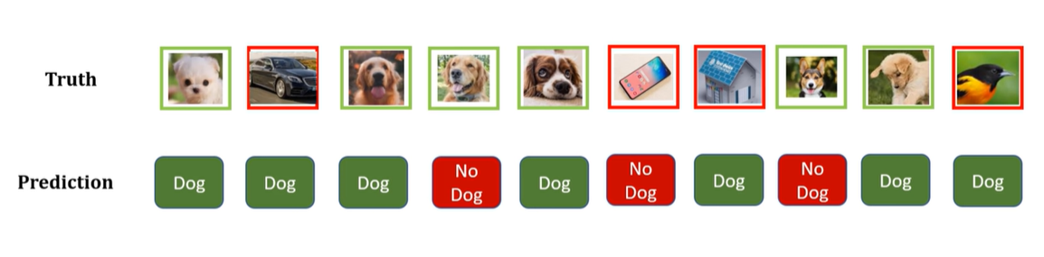
Confusion Matrix in Machine Learning

Slide 6
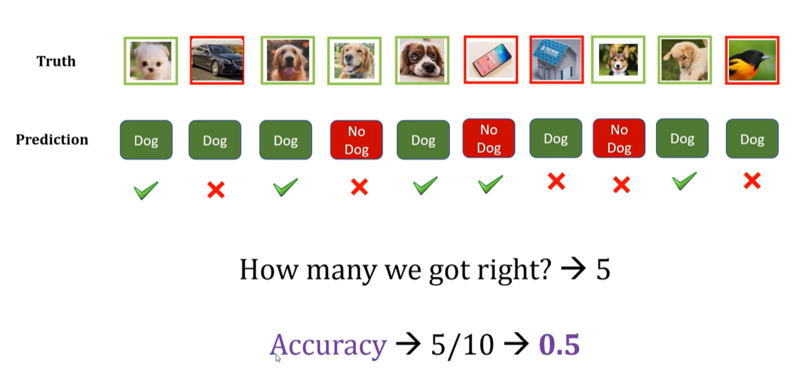
Confusion Matrix in Machine Learning

Slide 7
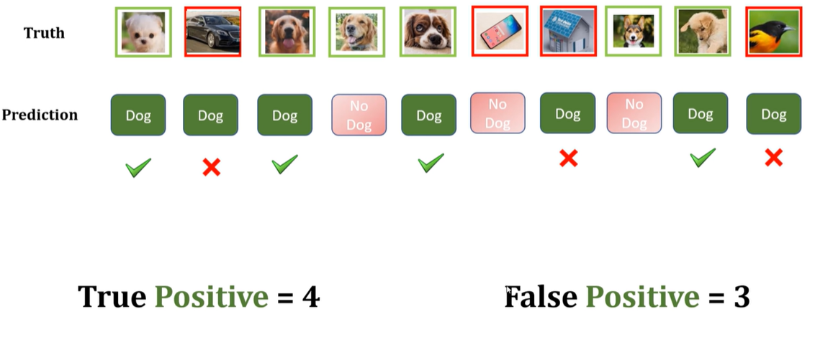
Confusion Matrix in Machine Learning

Slide 8
Confusion Matrix in Machine Learning

Slide 9
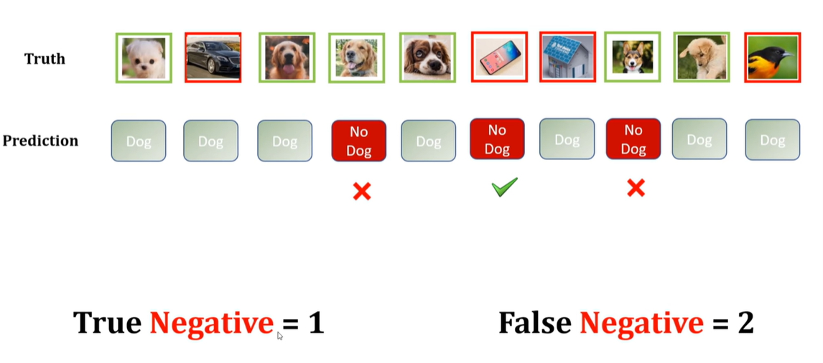
Confusion Matrix in Machine Learning

Slide 10
Confusion Matrix in Machine Learning

Slide 11
Confusion Matrix in Machine Learning

Slide 12
Confusion Matrix in Machine Learning

